Slide 1
AAC Coding
Jacky Lin
2010.8.25

Slide 2
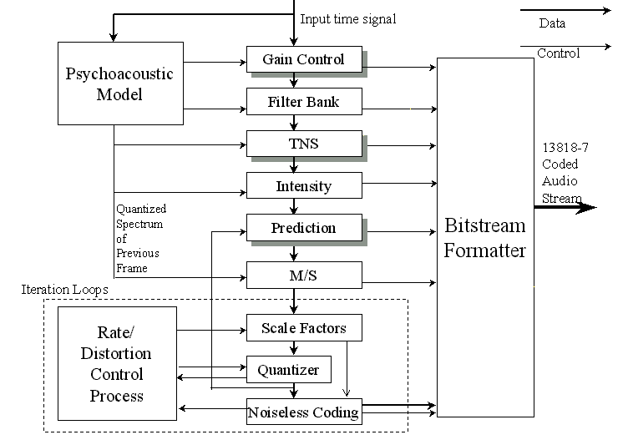
MPEG2 AAC Encoder

Slide 3
增益控制(Gain control)
在SSR profile中，加入了一个Gain control这个新的模块，这个模块利用PQF将时间上的讯号切割成四个相同宽度的频带，以达到scalable的效果，并经由增益(gain)的调整来减轻preecho的现象。

Slide 4
Temporal Noise Shaping (TNS)
TNS是感官式音讯编码(Perceptual Audio Coding)中的一个新的观念，目的在于使单一区块在经过时间-频率转换﹑量化及编码之后，音讯在区块内时间上的噪音遮蔽效果仍然能够维持。在加入TNS这个模块后，将可以发现preecho的现象被有效地被改善。

Slide 5
预测模块(Prediction)
预测模块的效果在于减少相邻音框之间的信息重复性(redundancy)。由于声音讯号在一般情形下，短时间内具有相当程度的相似性，所以如果采用相邻音框间互相预测的方法，可以去除这些相似的多余资料，以达到更好的压缩效果。由于AAC可以提供最高到96 kHz取样频率的编码，在这么高的取样频率下预测模块将扮演增加编码效率的重要角色。

Slide 6
MPEG4 GA(general audio)
More tools
PNS
LTP
TwinVQ
BSAC
SBR
PS
AAC LD
AAC ELD

Slide 8
PNS
Perceptual noise shaping
Used to improve the coding performance of noise-like signal

Slide 9
PNS

Slide 10
LTP
Long term prediction
Used to estimate the redundancy due to signal periodicity
Integrated with perceptual model (LTP for speech signals is usually accomplished in time domain)

Slide 12
TwinVQ
Transform-domain weighted interleave vector quantization
Low bit rate coding
≤ 16 Kb/s
≥ 6 Kb/s
Two steps :
Coefficients normalization
Parameters in normalization should be quantized and send out as side information
Quantization by weighted VQ
Interleave
VQ

Slide 13
Quantization of TwinVQ

Slide 14
BSAC(Bit Slice Arithmetic Coding)
The MPEG-4 BSAC is used in combination with the AAC coding tools and replaces the noiseless coding of the quantized spectral data and the scalefactors
The noiselessly coded bit-sliced data

Slide 16
SBR(Spectral Band Replication)
SBR (Spectral Band Replication) is a new audio coding enhancement tool. It offers the possibility to improve the performance of low bitrate audio and speech codecs by either increasing audio bandwidth at a given bitrate or by improving coding efficiency at a given quality level.

Slide 17
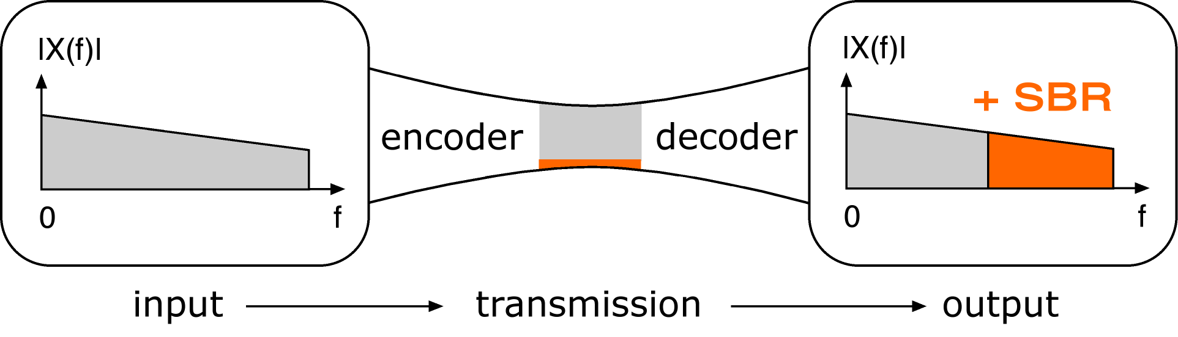

Slide 18
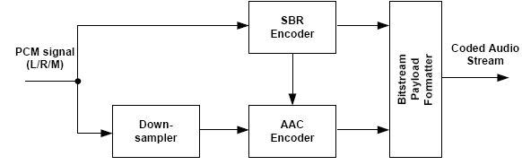

Slide 19
PS(Parametric Stereo)
Parametric Stereo performs sparse coding in the spatial domain, somewhat similar to what SBR does in the frequency domain.
the additional bitrate spent on the single mono channel (combined with some PS side info) will improve the perceived quality substantially of the audio compared to a standard stereo stream at similar bitrate

Slide 20
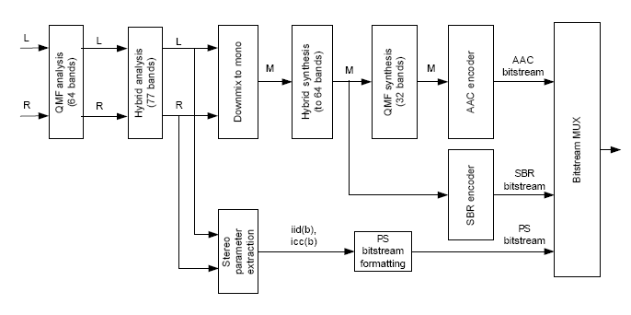

Slide 21
AAC LD
Requires higher data rates but provides near transparent voice and music with low delay.

Slide 22
AAC ELD
Combines the best aspects of low-delay audio coding with Spectral Band Replication to reduce bitrate. This combination creates a coding algorithm that is uniquely suited to real-time IP transmission. Using AAC-ELD with ACCESS allows full-fidelity high quality audio transmission at a data rate that easily fits into satellite and 3G wireless upload channels. One way ACCESS transmission delay using AAC-ELD is an easily-managed 50 milliseconds.

Slide 23
AAC Frame type
ADTS
ADIF
RAW DATA
LATM
LOAS

